Slide 1
Patterns of population structure and admixture among human populations
Katarzyna Bryc
OEB 275br
February 19, 2013

Slide 2
Outline
The field of population genetics
Learning about human history from genetics
Out of Africa settlement of continents
Admixture: gene flow between diverged populations
African American admixture
An update to Out of Africa

Slide 3
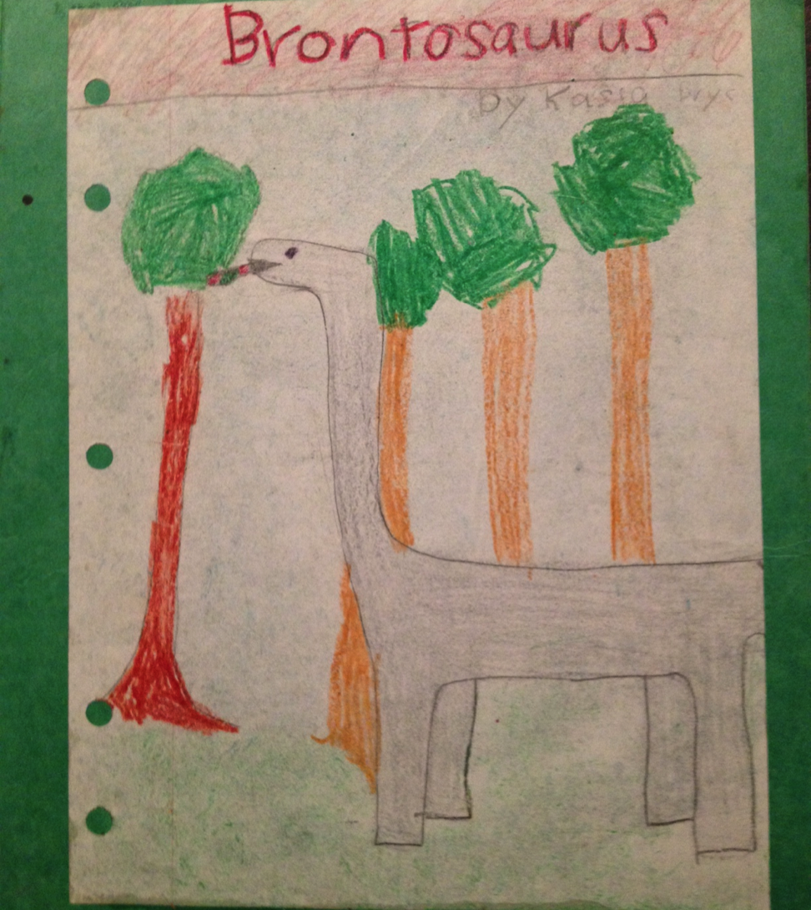
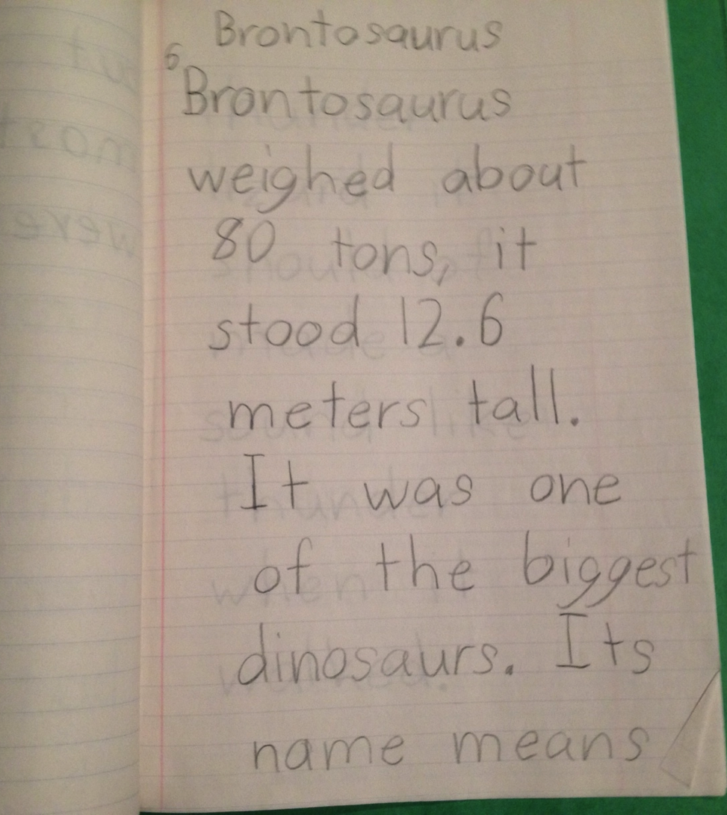
Early work

Slide 4
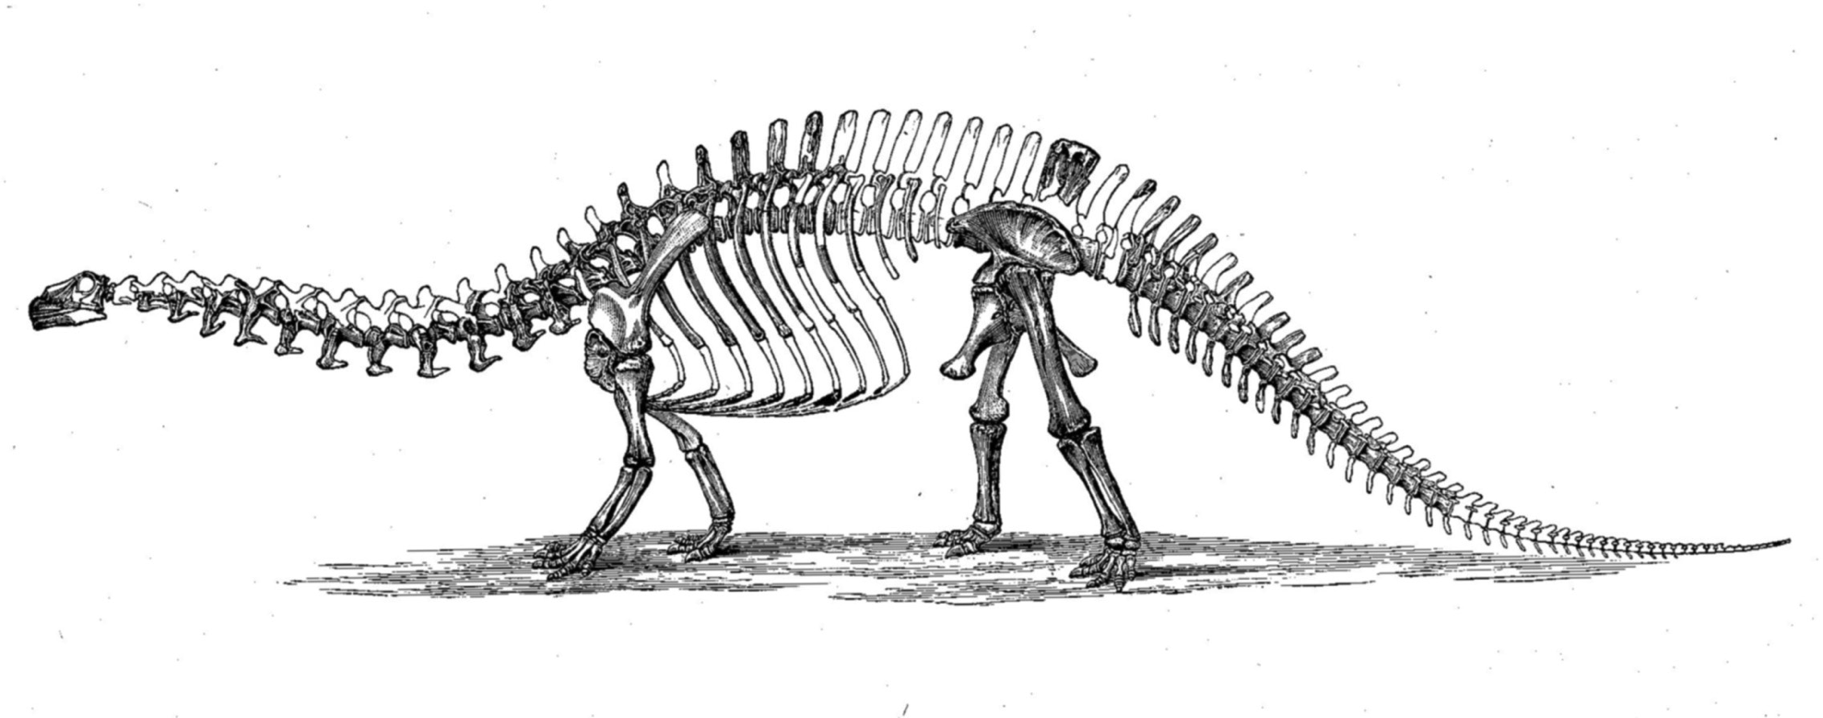
Er, Apatosaurus?
Reanalysis of data, or subsequent research, can lead to different conclusions
O.C. Marsh, 1896

Slide 5
Shift in the understanding of human history
New data from old bones leads to new conclusions
Museum collections will be key
Challenges:
DNA preservation and no modern contamination
Online databases
Huge resources
Challenges:
Human subjects research requires careful consent and ethics review

Slide 6
Outline
The field of population genetics
Learning about human history from genetics
Out of Africa settlement of continents
Admixture: gene flow between diverged populations
African American admixture
An update to Out of Africa

Slide 7
Population genetics
Sewall Wright, B.S. Haldane, R.A. Fisher
early 1900’s
Study allele frequency distribution and change
Evolutionary processes of
natural selection
genetic drift
mutation
gene flow
population structure

Slide 8
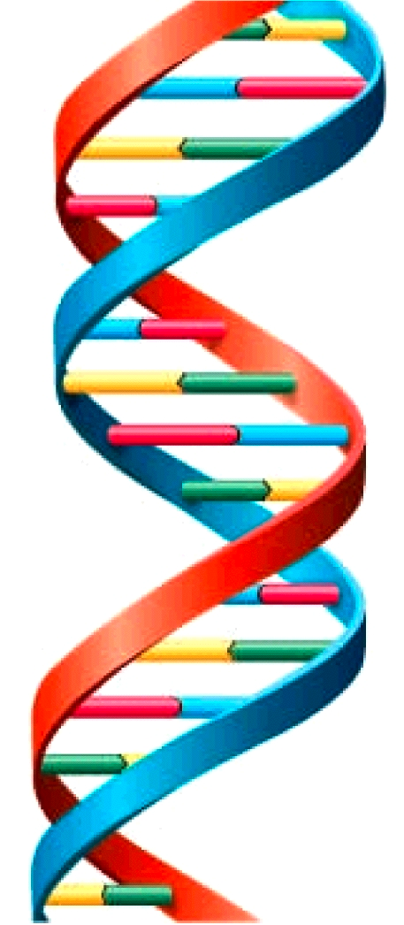
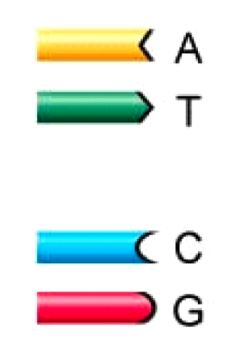
DNA
DNA
Reference
sequence
…TCAGGTCACAGTCT…
…TCAGGTCACAGTCT…
Individual 1
Individual 2
…TCAGGCCACAGTCT…
…TCAGGCCACAGTCT…
Individual 3

Slide 9
Single Nucleotide Polymorphism (SNP)
…TCAGGTCACAGTCT…
…TCAGGCCACAGTCT…
…TCAGGCCACAGTCT…
SNP
A.k.a. allele, locus, marker, variant

Slide 10
Mutation
time
Allele frequency: 1/N
Infinite sites model

Slide 11
Genetic drift
time
Allele frequency = 10%
Allele frequency = 30%
Drift is faster in smaller populations

Slide 12
Natural selection
Allele frequency = 30%
Allele frequency =50%
Selection strength s
What genes are under selection?

Slide 13
Population structure
67%
Population 1
Barrier
17%
Population 2
30%
Population substructure
Random mating within populations
Can have gene flow between pops
Randomly mating
Notes:
We can use these genetic markers to understand how populations are related!

Slide 14
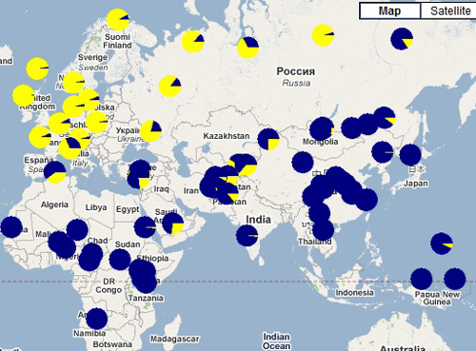
Pigmentation example - SLC45A2
ALFRED: The ALlele FREquency Database
http://alfred.med.yale.edu/alfred/

Slide 15
Outline
The field of population genetics
Learning about human history from genetics
Out of Africa settlement of continents
Admixture: gene flow between diverged populations
African American admixture
An update to Out of Africa

Slide 16
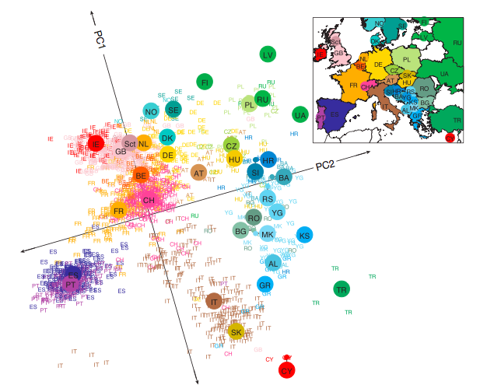
What can genetics tell us about population structure?
Principal Components Analysis (PCA)
Isolation-By-Distance
Novembre et al. 2008, Nature

Slide 17
Tools of the trade
Samples
Modern populations
Ancient DNA
Statistical Methods
PCA (Patterson 2006)
STRUCTURE (Falush 2003)
Technology
Genotyping arrays
Sequence data

Slide 18
Outline
The field of population genetics
Learning about human history from genetics
Out of Africa settlement of continents
Admixture: gene flow between diverged populations
African American admixture
An update to Out of Africa

Slide 19
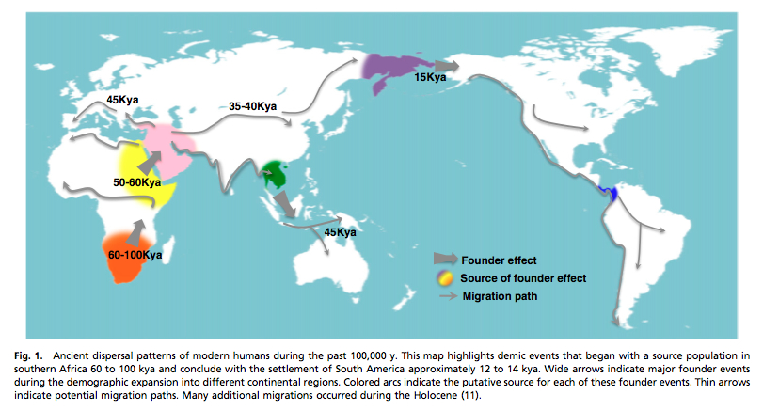
Out of Africa
Henn et al. 2012, PNAS

Slide 20
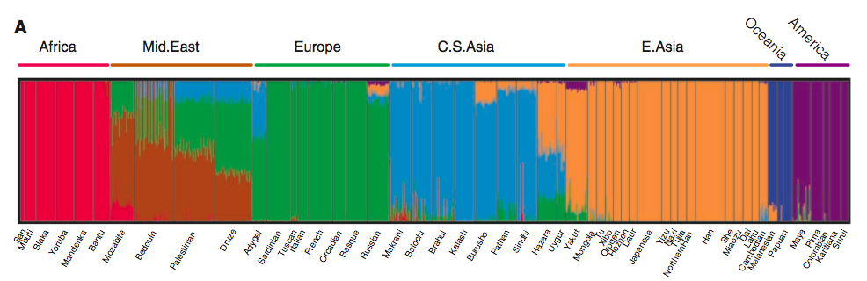
Worldwide substructure
Worldwide Human Relationships Inferred from Genome-Wide Patterns of Variation
Li et al. 2008, Science

Slide 21
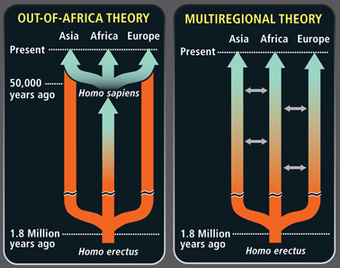
Admixture with Hominids?
Gene flow from archaic populations (ie, Neandertals) into modern humans?
Scientific American

Slide 22
Outline
The field of population genetics
Learning about human history from genetics
Out of Africa settlement of continents
Admixture: gene flow between diverged populations
African American admixture
An update to Out of Africa

Slide 23
What is admixture?
1
2
Ancestral populations
Gene flow between populations
G1
In subsequent generations segments become shorter
G2

Slide 24
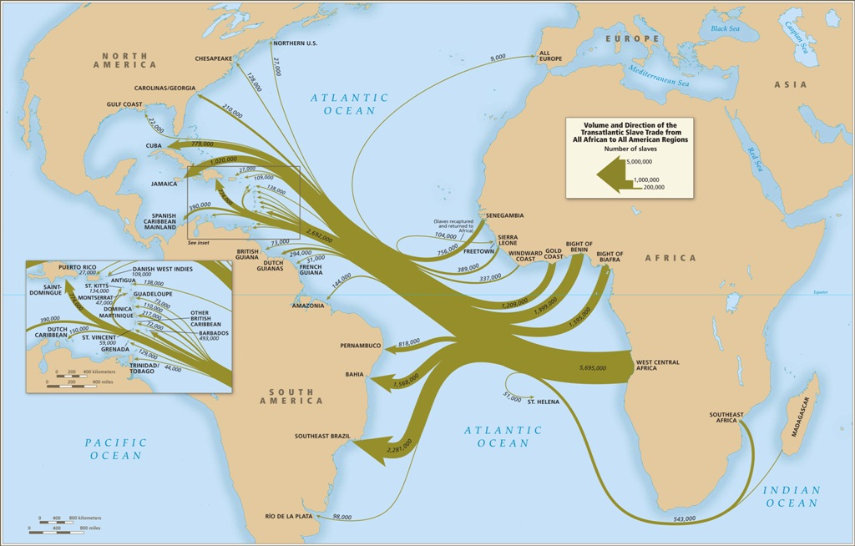
What we know from history about the Trans-Atlantic Slave Trade
From: Atlas of the Transatlantic Slave Trade, Eltis and Richardson, based on www.slavevoyages.org
Notes:
----- Meeting Notes (11/6/12 19:17) -----
Question of what the genetic ancestry is of afams in the US today.
----- Meeting Notes (11/7/12 12:03) -----
Historians have painstakingly investigated records of the trans atlantic slave trade that brought over about 500,000 afams from different regions of africa, into the US through different ports.

Slide 25
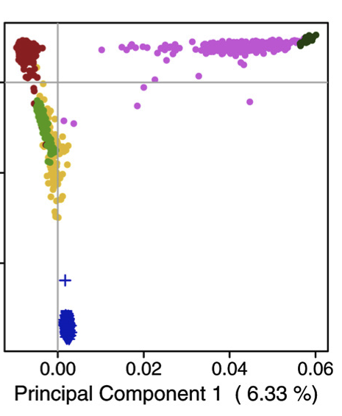
African American admixture
Can we learn more using genetic data?
Africans
Europeans
South Asians
African Americans
East Asians
Notes:
Can we learn more about which African populations or groups contributed ancestry to African Americans in the U.S. by studying autosomal, high density, genetic data?
Can we detect differences in proportions of ancestral African populations among Afams from different parts of the U.S.?

Slide 26
What we know from genetics
African ancestry primarily from West Africa
[Lovejoy 2000, Salas 2005, Price 2009, Tishkoff 2009]
Variation in African vs. European ancestry proportion
[Parra 1998, Parra 2001, Smith 2004, Lind 2007, Bryc 2010]
Evidence for sex-bias in ancestry contributions
[Parra 2001, Lind 2007, Bryc 2010]
Notes:
what we know from genetics about the African ancestry of African Americans

Slide 27
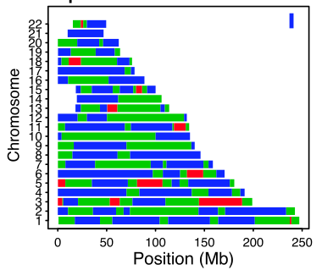
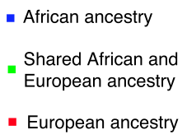
Local ancestry “Chromosome painting”
African vs European proportions vary
Sex bias in ancestry contributions
mtDNA and Y chromosome haplotypes
Bryc et al. 2010, PNAS
Notes:
Who has seen such a figure before?
Lots of methods for this – LAMP, HapMix, PCADMIX, ChromoPainter. These results, and clustering methods such as FRAPPE, STRUCTURE, ADMIXTURE
But this is only for African/European ancestry – doesn’t tell us proportions of where this individual came from within African;

Slide 28
Outline
The field of population genetics
Learning about human history from genetics
Out of Africa settlement of continents
Admixture: gene flow between diverged populations
African American admixture
An update to Out of Africa

Slide 29
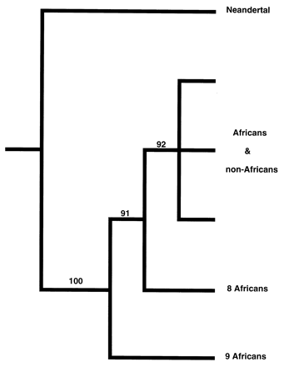
Hunt for Neandertal admixture
mtDNA does not recombine
Neandertal outgroup to all modern humans
No signal of admixture
Last common ancestor ~ 500,000 years ago
~500kya
mtDNA tree

Slide 30
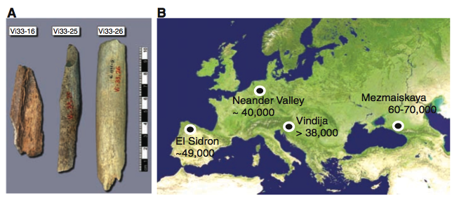
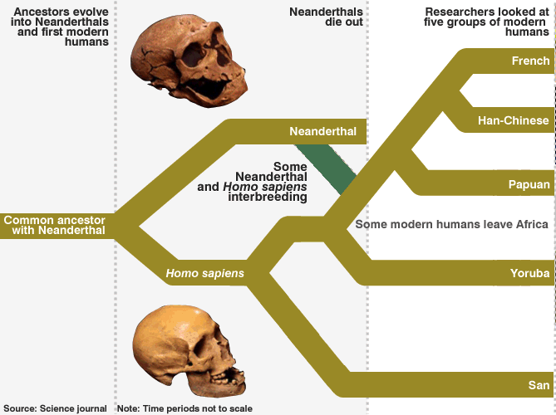
Neandertal autosomal genome
Bone powder -> much work -> DNA sequence
Analysis reveals low levels of gene flow into all non-Africans
Explore the Neandertal genome on Ensembl or UCSC Genome Browser
A Draft Sequence of the Neandertal Genome
Green et al. 2010, Science

Slide 31
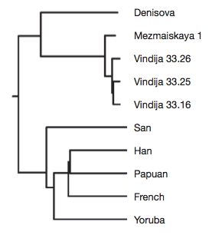
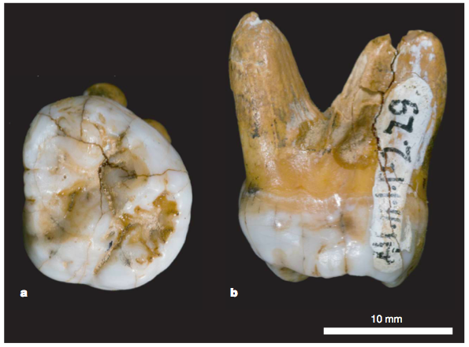
Another hominid: Denisova
Tooth and finger bone from Altai mountains in Siberia
Distinct from Neandertal
Analysis reveals gene flow into modern humans, but only into Oceania
Australia and Papua New Guinea
Neandertal
Modern
humans
Genetic history of an archaic hominin group from Denisova Cave in Siberia
Reich et al. 2010, Nature

Slide 32
Admixture appears to be quite common in human history
Sequencing of two archaic genomes reveal both had gene flow into modern humans
Further, evidence of archaic gene flow into Africans (of unknown origin)
Lots of other expansion and admixture events (European Farmers, Bantu expansion in Africa)

Slide 33
Database resources
ALFRED (ALlele FREquency Database)
dbGaP (database of Genotypes and Phenotypes)
NCBI: National Center for Biotechnology Information, through NIH
UCSF Genome Browser, Ensembl
Publicly available data generated thanks to:
Neandertal Project
Haplotype Map Project (HapMap)
1000 Genomes Project
Human Genome Diversity Project (HGDP)
Human data has some unique challenges

Slide 34
Thanks!

Slide 35
A simple model of admixture
t
G
Africa
African Americans
Europe

Slide 36
True admixture history more complex
Africa
African Americans
Europe

Slide 37
African populations analyzed
Chadic
Far West Africa
West Africa
East Africa
Pygmy
Central Africa
Notes:
To limit the dimensionality of the models we explored, we considered the African populations with the following first approximation clusters

Slide 38
Ancestry estimates based on allele frequencies
Linear model like method
Statistical support for at least five populations contributing ancestry to African Americans:
Europe
West Africa
Far West Africa
Central Africa
Native American
Far West Africa
West Africa
Central Africa
QPMIX: Patterson et al. (2010) Human Molecular Genetics
Notes:
Model admixed population as a mixture of ancestral; framework for testing significance of additional components

